Slide 1
BPMS
Divine APEX Program MUFG Reverse Factoring Enhancements
GB_Hopper-9162
Kasavathala Venkata, Kirankumar
Shalini Akunuru

Slide 2
(ADM) Business Process Management System framework and toolkit
BPMS Phase
Step 1
Step 2
Step 3
Step 4
Step 5
Step 6
Step 7
Transitions SG
Stage Gate 1: Design
Stage Gate 2: Transfer
Stage Gate 3: Run
BPMS Steps
Build detailed process
Framework
Operation Excellence Risk Assessment
Finalize (input-process-output)
Metrics
Measurement System & Quality Framework setup
Set-up
Reporting
Structure
Visual
Management standardization
Continuous Improvement Roadmap
Key outcomes
Project Charter
Validated Process Steps
Validated Process Maps
Communication plan on project
Current Process Capability Analysis:-
Baselining
FTE Estimation
Risk Assessment / Operational FMEA
Metric Identification
Input measures
Process measures
Output measures
Operational definitions
Set up of repeatable reliable metrics
Baselining on SLA & Target setting
Quality Framework
Governance & Escalation Structure
Reporting Framework
Dashboard designs
Visual Management designed & implemented
LOS for
Process improvement
Basic (QPA) and advance (RPA) automation
Transformation opportunities
Toolkit
Current
SOPs
Kano
ARMI / RACI
Comms Plan
COPIS
Process Mapping (Visio/ PPT)
FMEA (Risk Register/Gprompt)
Volume Baselining
and forecasting (Estimation)
FTE validation (Estimation)
Metric Matrix (Measurement Plan/PPM Workbook)
Data Collection Plan
Measurement System Analysis using Gage R&R
Quality Framework
Client governance templates
Reporting matrix
Excel based Dashboards
Escalation Matrix template
Governance in Action
Whiteboards, display walls
CI roadmap / VGR
++
Smart Modeler
Epiplex
Service Lines based Risk CMP 1.0
Benchmarking tool
SEPs (OnePAL measurement framework for lifecycle)
WAM (Gprompt,PHI)
Digital Twin
FLM Cockpit
Quality Control framework
Benchmarking tool
Digital Dashboards/ Visualization tools (PHI)
Red Phone/ Escalation Matrix
Digital Dashboards/ Visualization tools Mojo Meter (PHI)
Gemba Checklist
VSM
Prioritization Matrix
(ReuBank, IdeaBox)
*
Recommended Timelines
1-2 weeks
2-3 weeks
2-3 weeks
1-2 weeks
2-3 weeks
2-3 weeks
2-3 weeks
*Its recommended to align the project timelines with that of the Transition timelines
Replication: Project documentation MUST present evidence of leveraging existing repositories/ tools that provide benchmark information for a related activity

Slide 3
Step 1 Building Process Framework

Slide 4
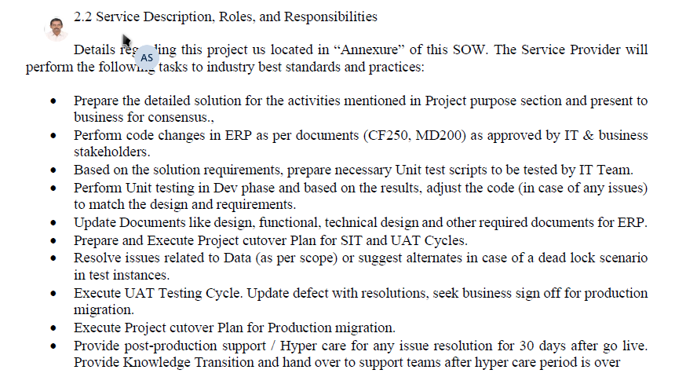
Step 1: Building Process Framework
VOC
“Genpact Process Owner VOC”
K Sasikiran – AVP SAP CoE
“Setup ADM process framework for Divine APEX Program MUFG Reverse Factoring Enhancements”
Client & GOL VOC to kick start the project, understand their expectations & document as measures of success

Slide 5
Step 1: Building Process Framework
BPMS Project Charter
GE provides a diverse range of services befitting a solution-building partner with a the ability to address various client issues, business activities and marketing plans at both the corporate and organizational levels. GE extends its activities to serve societal needs, and strives to support innovation within society as a whole. In April 2020, they decided to transition their P2P processes like Invoice processing and Payments Suctioning to Genpact for US region.
Business Case
To have a structured development plan with regular governance rhythm, actions, timelines, and owners to improve employee satisfaction and to foster a culture of continuous improvement.
Process Criticality
Correct and timely resolution to the client’s request is key to the success. Incorrect / Inappropriate requirement handling may result in client dissatisfaction and we might loose an opportunity to get more business. With this process standardization, we aim to be more accurate and efficient by defining procedures, fixing responsibilities and ownership at each step, defining timelines and establishing a complete review mechanism
Project Criticality
Robust System of metrics - measurable system to enable data capturing, reporting and analysis which will lead to effective opportunity identification and help achieve the process goals .
Performance Dashboard - Weekly Performance Tracker (with Timelines, Owners & Backup’s)
Risk Analysis to identify High Risks and Current Controls
Identify potential improvement opportunities.
Key Project Deliverables
In scope: US region
Out of scope: Other activities retained onshore (Vendor master creation , Review/Approval, Employee creation, T & E)
Starts: Once Invoice/Expense/Vendor request received
Stops: Once clearing of payment is done after reconciliation.
Boundaries
Project Leader – Kasavathala Venkata, Kirankumar
Champion - Sasikiran K
Mentor - Shalini Aknur
Project Team

Slide 6
Step 1: Building Process Framework
BPMS ARMI and Communication Plan
Stakeholder | Role | Risk Assessment | Measurement System | Insights and improvement
Anupam Jain | Sponsor | A | A | A
Sasikiran K | Champion | A | A | A
Deepak Chopra | Quality Leader | A | A | A
Dheeraj Mathur | MBB | I | I | I
Shalini Akunur | Black Belt | I | I | I
Kirankumar | Project Owner | A | A | A
Swathi P, Rajesh D | Project Team | M | M | M
A Approval of team Decisions e.g. Sponsor, Champion, MBB.
R Resource to the Team, one whose expertise skills may be needed on ad-hoc Basis
M Member of the team, with the authorities and boundaries of the Charter
I Interested party, one who will need to be informed

Slide 7
Step 1: Building Process Framework
BPMS Communication Plan
Event | Responsibility | Message | Audience | Frequency | Date
Kick Off Meeting | Kiran Kumar | Discussion on project Initiation | Vivek GPM, Srini P SPM, Vamshi G: GPM – Genpact Mentor | One time | 27-Apr-20
Governance Call | Kiran Kumar | Progress Updates | SAP Head – Sasikiran AVP, Vivek GPM, Srini P SPM, Vamshi G: GPM – Genpact Mentor and Project Team | Monthly | May’20 Onwards
BB Status Meeting | Kiran Kumar | Discussion on project progress | Mentor; Project Team | Weekly | Ongoing
Phase Completion Review | Kiran Kumar | Discussion on project Phase completion | Mentor; Master Coach | Phase Completion | Jun’20 Jul’20 Aug’20 Sep’20
Panel Review | Kiran Kumar | Project review | Mentor; Master Coach; Quality Leader | One time | Aug’20 Sep’20

Slide 8
Step 1: Building Process Framework
Project Plan for BPMS Project

Slide 9
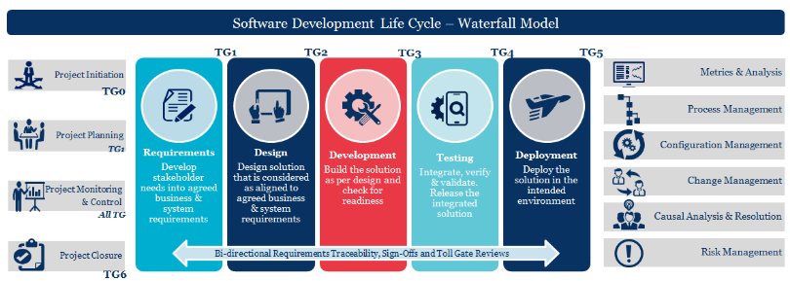
Step 1: Building Process Framework
COPIS – Waterfall Methodology
O
P
Process
S
C
Output
I
Supplier
Customer
Input
Software/Code
Design Documents
Test Results
Requirements
SOW
Test Data
GE
HR
IT Team
Support Teams
Vendors
Start
End

Slide 10
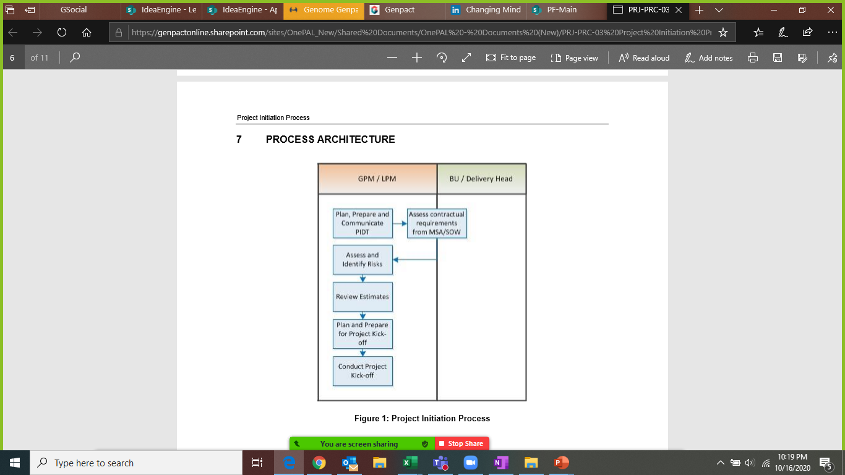
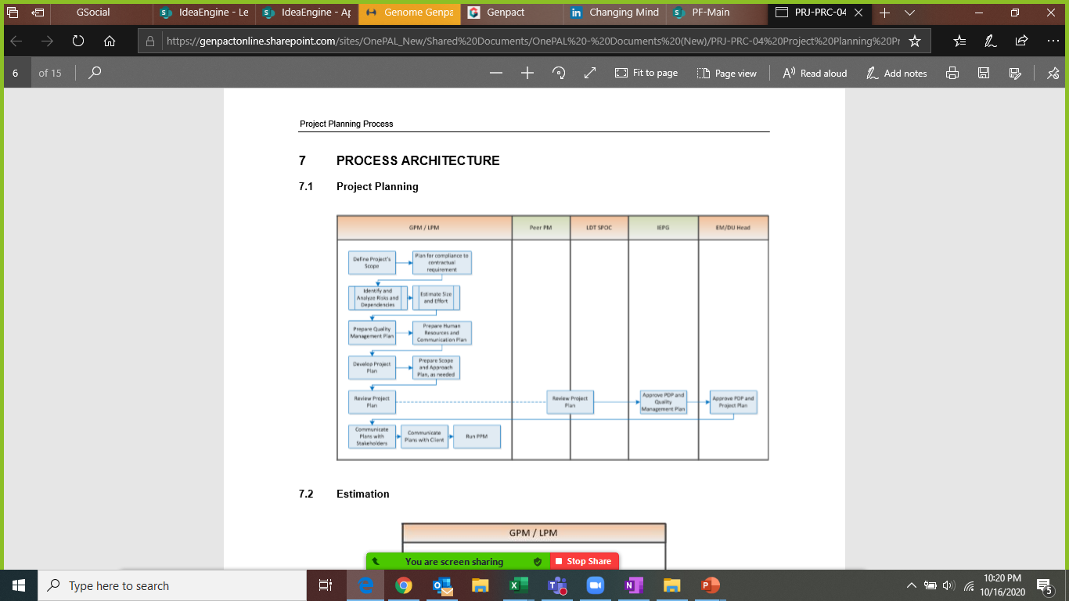
Step 1: Building Process Framework
Project Initiation
Project Planning

Slide 11
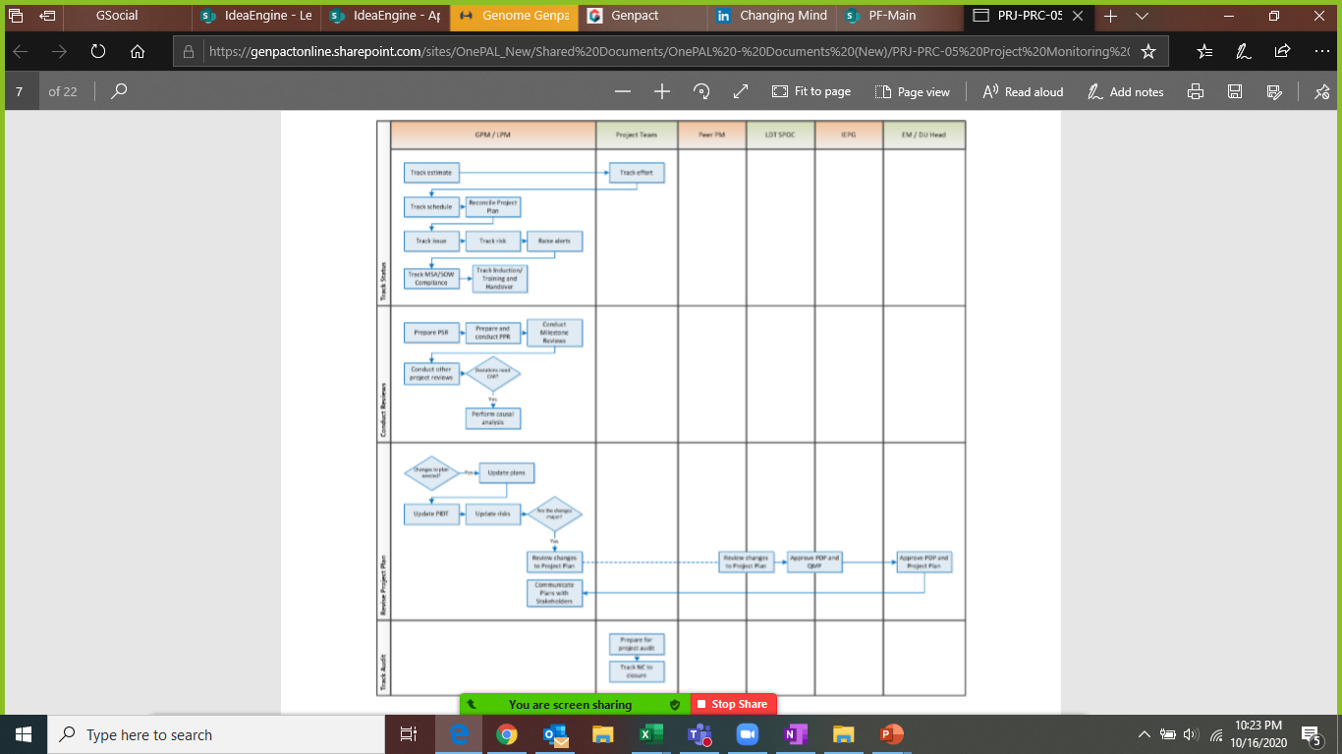
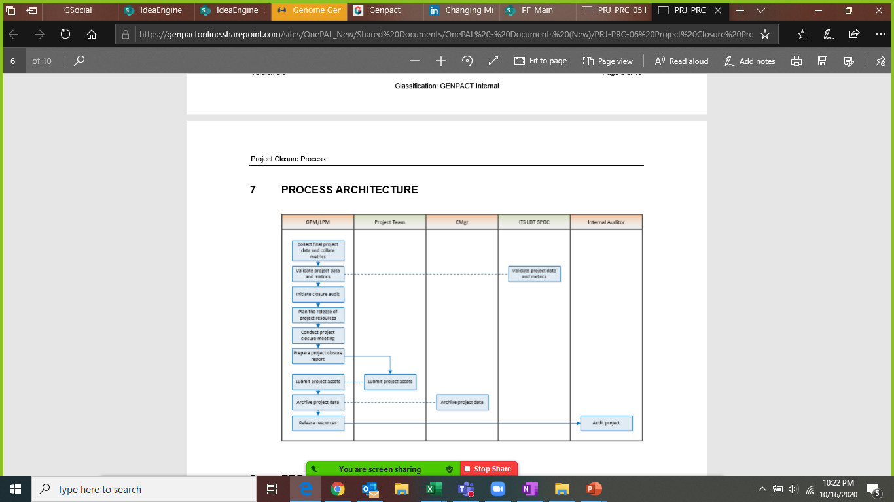
Step 1: Building Process Framework
Project Monitoring & Control
Project Closure

Slide 12
Step 2 Operational Excellence Risk Assessment

Slide 13
Step 2: Operational Excellence Risk Assessment
Risks in the Project /Process

Slide 14
Step 2: Operational Excellence Risk Assessment
Data Collection Plan
Measure / Metric | Data Type | Operational Definition | Stratification / Sampling Factor | Method of Collection | Owner
Weighted Defect Removal Efficiency | Continuous | # of weighted Internal defects/Total (weighted internal and weighted external)defects | Technology and complexity | From PPBR database | PM
Effort Deviation | Continuous | Planned Effort -Actual Effort/ Planned Effort | Technology and complexity | From PPBR database | PM
PCS- Process Compliance Score | Continuous | PCS from 0% to 100% | Technology and complexity | From PPBR database | PM

Slide 15
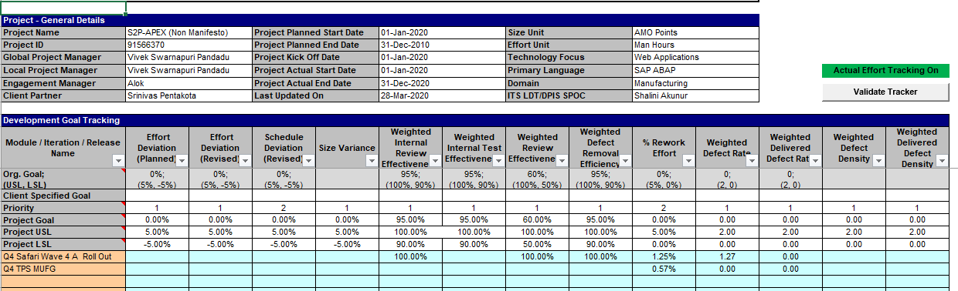
Step 2: Operational Excellence Risk Assessment
Project dashboard
Please visit below link to set your targets basis selected lifecycle and metrics
https://app.powerbi.com/groups/c675e9c8-23b6-4187-b0ca-8c01082e2969/reports/ac3ba929-bee7-4f6e-add2-3c65823be174/ReportSectionb3451be53337bcc6cb8a

Slide 16
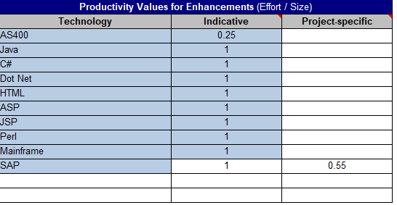
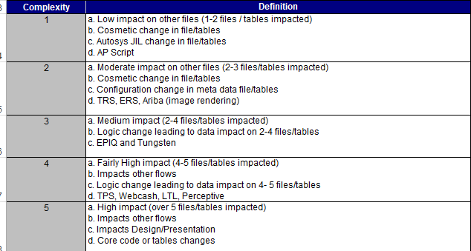
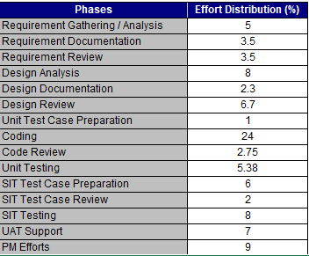
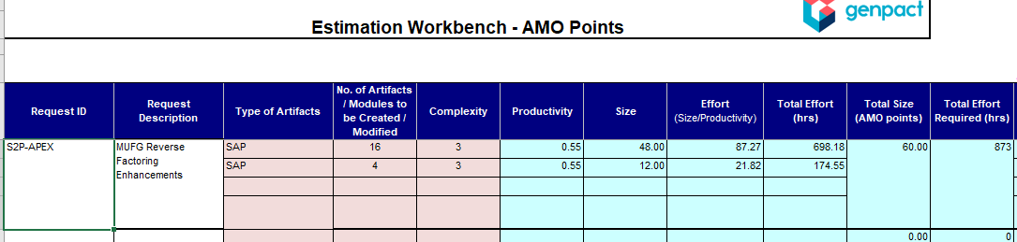
Step 2: Operational Excellence Risk Assessment
FTE Estimation- Basis Size & Effort

Slide 17
Step 3 Finalize ( Input, Process and Output) Metrics

Slide 18
Step 3: Finalize (input / process / output) Metrics
BPMS ► Finalizing Metrics (Input, Process & Output)
Metric Matrix – Waterfall Methodology
Metric | Measurement Objectives | Priority of Measurement Objective | Base Measures | Collection Technique | Consolidation and Analysis Technique | Responsibility | Frequency of Analysis and Reporting
<Effort Deviation> | Increase EBIDTA - Delivery within budget | 1 | Planned Effort Actual Effort> | Project Tracker | Consolidation: Project Tracker Analysis: 7 QC Tools | Offshore Dev LPM / Technical Lead | Monthly
<Schedule Deviation> | Achieve and Sustain Customer satisfaction - CSAT | 2 | Planned Schedule Actual schedule | Project Tracker | Consolidation: Project Tracker Analysis:7 QC Tools | GPM | Release-wise
<Weighted Defect Removal Effectiveness> | Achieve and Sustain Customer satisfaction - CSAT | 3 | # of weighted external and Internal Defects | Project Tracker | Consolidation: Project Tracker Analysis: 7 QC Tools | GPM | Release-wise
PCS- Process Compliance Score | Compliance to defined process | 4 | PCS from 0% to 100% | Audit Checklists, Auditing Tool | Consolidation: Applicable Audit Checklist, Auditing Tool Analysis: 7 QC Tools | GPM | Quarterly

Slide 19
Step 4 Setting up Measurement System

Slide 20
Step 2: Operational Excellence Risk Assessment
Data Collection Plan
Measure / Metric | Data Type | Operational Definition | Stratification / Sampling Factor | Method of Collection | Owner
Weighted Defect Removal Efficiency | Continuous | # of weighted Internal defects/Total (weighted internal and weighted external)defects | Technology and complexity | From PPBR database | PM
Effort Deviation | Continuous | Planned Effort -Actual Effort/ Planned Effort | Technology and complexity | From PPBR database | PM
PCS- Process Compliance Score | Continuous | PCS from 0% to 100% | Technology and complexity | From PPBR database | PM

Slide 21
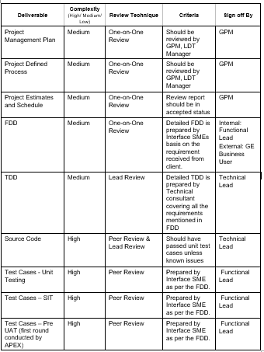
Step 4: Set Up Measurement System
Quality Framework- Quality Management Plan
Work product review plan

Slide 22
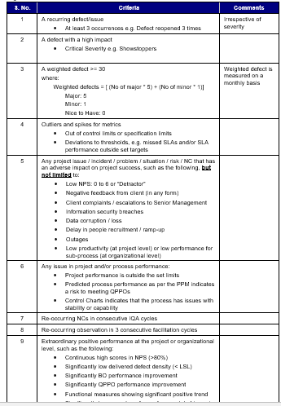
Step 4: Set Up Measurement System
Quality Framework- Quality Management Plan
CAR/Defect prevention plan

Slide 23
Step 5 Setting Up Reporting Structure

Slide 24


Step 5: Setting Up Reporting Structure
BPMS Live ► Step 5 ► Setting Up Reporting Structure
Client Governance
Client
Genpact
Key discussion points
CXOs
Client Functional /
Business Leads
Quality Team**
COO
Sr. GOL
GOL
SDL
GRM / Client Partner
DPIS MBB**
Quarterly Program & Executive Governance
Provide strategic direction to the partnership
Review performance and relationship overall
Seek sponsorship for new opportunities /New Projects initiationl
Steering
Committee
Process Owners /
Service Delivery Managers
Process Managers
Quality Team**
GOL
SDL
Process Managers
DPIS MBB/BB**
Monthly
Operations & Quality Review
Review scorecard and performance
RCA for critical error category and Action Plan
Error Trends & Learnings
Discuss any potential risks & actions thereof
DPIS Review
Review CI roadmap progress as per plan
Management Committee
Process Managers (client)
Daily/Weekly (based on account needs)
Daily operational management
Identify and resolve key process issues
Process Owner Connect
Process Manager (Genpact)
New**
Quality Leader
Quality Manager
Regional Process Owners
SDLs
DPIS MBB
DPIS BB
Quarterly (separate for F&A + non F&A teams)
Status of Projects & Improvement Initiatives
Status of agreed ongoing Action Items
Best Practice & Learnings
Best Practice Sharing Sessions - Monthly in Q4 FY 19 (Later to be revised basis requirement)
Discussion on improvement opportunities across all regions
Quality
Governance

Slide 25
Step 5: Setting Up Reporting Structure
Reporting Matrix
Report | Report Location | Frequency of Update | Frequency of Publishing | Audience Client / Internal | Distribution List | Report Owner
Project Progress Review | GE Smart sheet | Weekly | Weekly | Client, GPM, and Rollout lead, Functional lead, Technical lead and Project team | Client, GPM, and Rollout lead, Functional lead, Technical lead and Project team | GPM
Program Progress Review | GE Box folder | Quarterly | Quarterly | Client, Account Lead, GPM, and Rollout lead, Functional lead, Technical lead and Project team | Client, Account Lead, GPM, and Rollout lead, Functional lead, Technical lead and Project team | GPM
Internal Review | Project sharepath | Weekly | Weekly | GPM, and Rollout lead, Functional lead, Technical lead and Project team | GPM, and Rollout lead, Functional lead, Technical lead and Project team | GPM

Slide 26
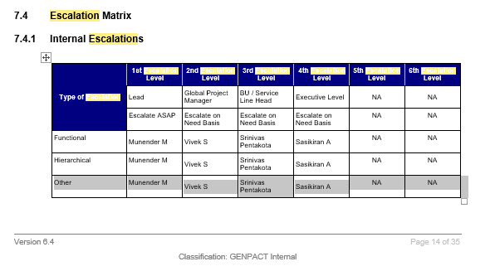
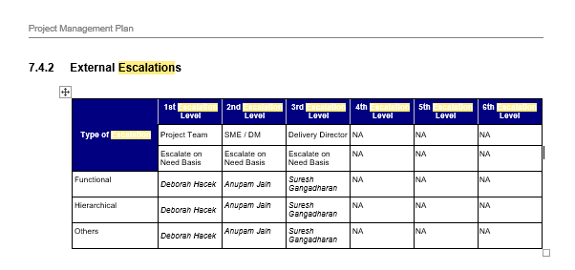
Step 5: Setting Up Reporting Structure
Red Phone / Escalation Matrix

Slide 27
Step 2: Operational Excellence Risk Assessment
Risks in the Project /Process

Slide 28
Step 6
Visual Management Standardization

Slide 29
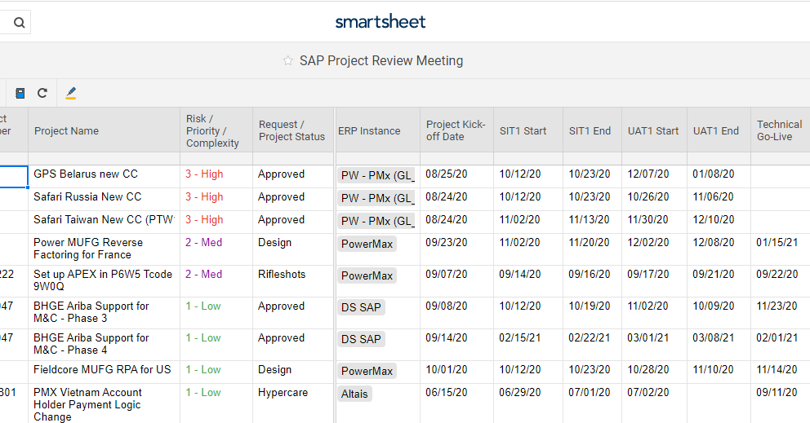
Step 5: Setting Up Reporting Structure
Dashboards – Customer Status Report Dashboards

Slide 30




Step 6: Visual Management Standardization
DPIS, Ops Effectiveness
LSS DNA
Take charge, say it with
Amber
Emma
On-demand Op Excellence!
Genpact’s new culture assistant, powered by AI
LSS DNA
Emma
On-demand Op Excellence!
Lean T & T %
Ideas Generated
% of people who have chatted
100%
6
100%
Lean Certified%
Ideas Approved
% of GB Owners Chatted
100%
6
100%
GB T & T %
Ideas Completed
% of Lean Owners Chatted
100%
6
100%
GB Certified%
BI Delivered
20%
0 MM
Communication Templates

Slide 31
Step 7 Continuous Improvement Roadmap

Slide 32
Process Map – Kaizens
Master data issues
Setup issues
Code issues
Quote submitted in SFDC
User trainings issues
SFDC
PO Creation
Goods Receipt
Invoice posting
Payment run
Payment file generated
Payment from TRAX
SAP

Slide 33
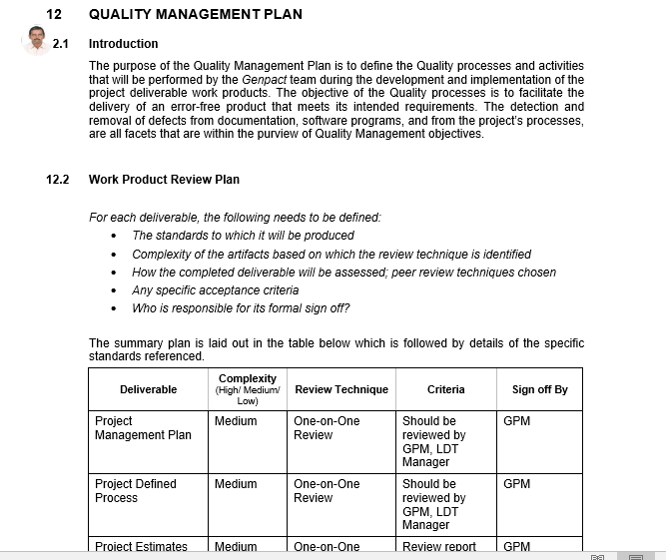
Step 7: Continuous Improvement Roadmap
Quality plan and Service Improvement plan snapshot

Slide 34
Step 7: Continuous Improvement Roadmap
BPMS Live ► Step 7 ► Continuous Improvement Opportunities ►
Year Name- 2021 Roadmap
Jan
Feb
Mar
Apr
May
Jun
Jul
Aug
Sep
Oct
Nov
Dec
Ideation Labs
Shared Pool Fragmentation
Proactive index maintenance
Idea Prioritization & Quantification
Reorganization of Master data
Process correction to reduce rework
Automation of Code naming conventions
Enabling email option from TRAX
Recompilation of Invalid Objects
Reduction of errors during payment process
Automation of Testing
Proactive Performance Monitoring
Automation of checking file system utilization
Implementation of best practices from other accounts and Lean Ideas (Automation Of reports, etc)
LEAN
Six Sigma
Notes:
34

Slide 35
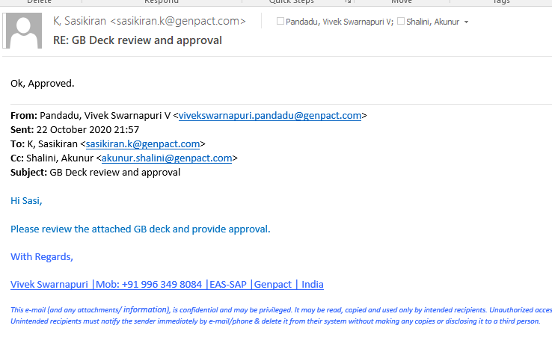
Project Approvals
Champion Approval Email

Slide 36
Thank You.

